Slide 1

Department Of Information Science and Engineering
Mini Project (ISP67)
Emotion Companion: Personalized Real-Time Emotion Recognition
and Adaptive Interaction System
Team Members :
Guided By :
Shruthi J R
Assistant Professor
Name | USN
Shreyas S G | 1MS23IS118
Susheel Kumar Naik S | 1MS23IS132
Thilak M | 1MS23IS134
Varun R | 1MS23IS141

Slide 2
Introduction
Facial Emotion Recognition (FER) is a computer vision application that identifies human emotions from facial expressions.
Emotion recognition plays an important role in human-computer interaction, healthcare, education, and entertainment systems.
Traditional systems often suffer from unstable predictions due to lighting variations, facial movements, and individual expression differences.
This project proposes a Baseline-Aware Temporal Facial Emotion Recognition system using ConvNeXt-Tiny for accurate and stable real-time emotion detection.
The system integrates OpenCV face detection, temporal probability smoothing, baseline calibration, and emotion-based music recommendation.

Slide 3
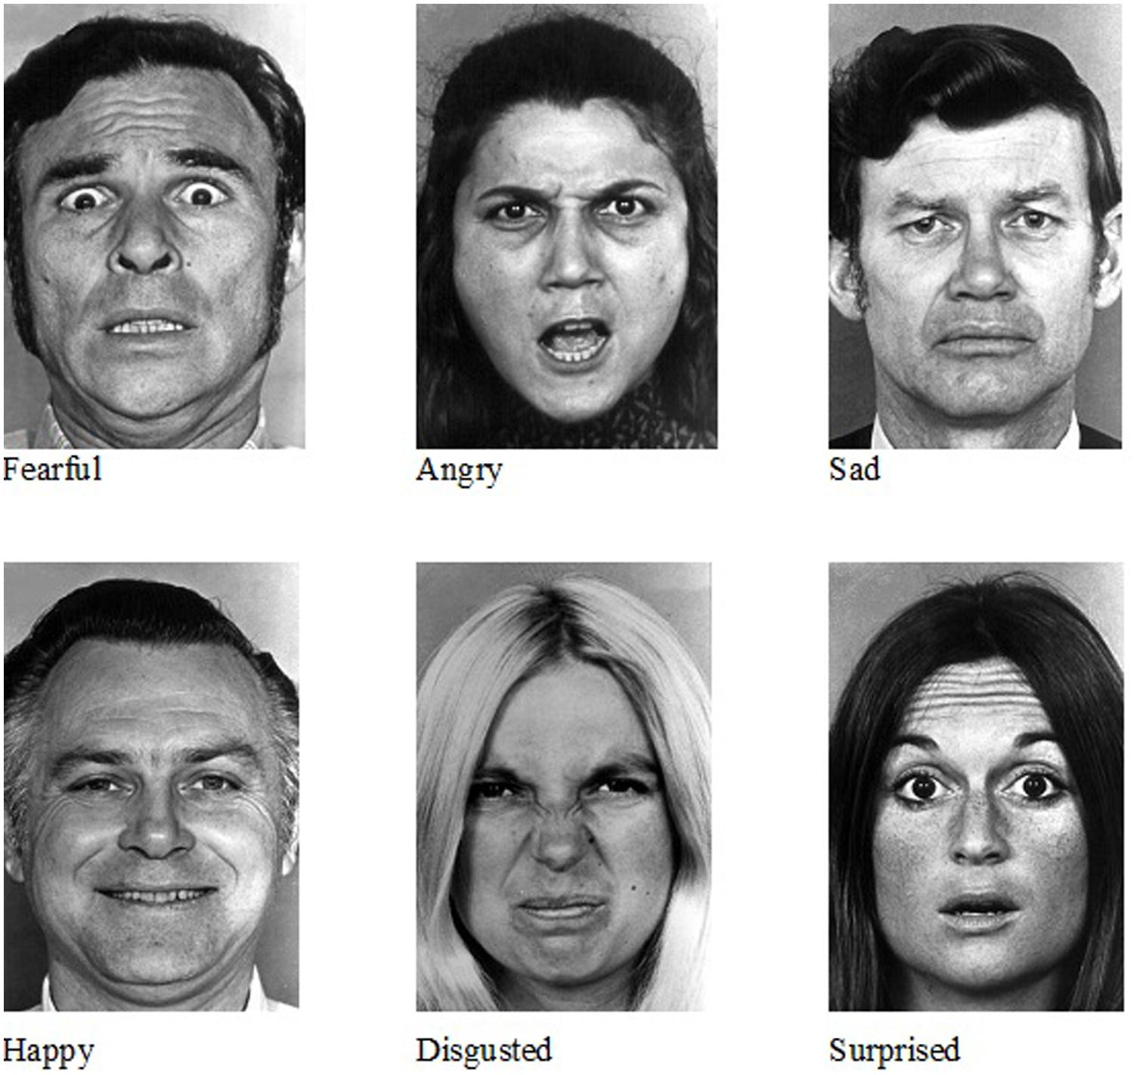

Slide 4
Problem Statement
Facial Emotion Recognition systems play an important role in human-computer interaction and intelligent applications. However, existing systems often suffer from prediction instability due to lighting variations, facial movements, and differences in individual expression patterns. These limitations can affect recognition accuracy and user experience in real-time applications. Therefore, there is a need for a stable and personalized emotion recognition system capable of providing reliable real-time emotion prediction.

Slide 5
Motivation and Scope
Growing demand for intelligent systems that can understand human emotions.
Need for stable and accurate real-time emotion recognition.
Requirement for personalized emotion analysis based on individual expression patterns.
Integration of emotion recognition with practical applications such as music recommendation.
Development of a web-based system for real-time emotion monitoring and interaction.

Slide 6
Objectives
To develop a real-time facial emotion recognition system using OpenCV and ConvNeXt-Tiny.
To improve prediction stability through temporal probability smoothing.
To implement baseline-aware emotion calibration for personalized emotion analysis.
To provide emotion-based music recommendations through an interactive web application.

Slide 7
Literature Survey
Authors | Paper Title | Method Used | Accuracy | Limitation
Aryan Al Zadjali, Abdullah Al Balushi, Mahmood Al Mahrooqi et al. (2026) | Face Detection and Emotion Recognition Using Convolutional Neural Network | CNN with Batch Normalization, Dropout and Data Augmentation | ~70% Validation Accuracy | Difficulty distinguishing similar emotions such as Fear and Surprise; slight overfitting observed.
Abdoul Malik, Selvakumar J., Srikanth Reddy et al. (2025) | Deep Learning for Facial Emotion Recognition on the FER-2013 Dataset using the ResNet50v2 Model | ResNet50V2 Transfer Learning with Data Augmentation | 69% Test Accuracy | High computational complexity and reduced performance on minority emotion classes.

Slide 8
Literature Survey
Authors | Paper Title | Method Used | Accuracy | Limitation
Sahil Naik, Varun T. K., Chandan M. et al. (2026) | Facial Emotion Recognition on FER-2013 using an EfficientNetB2-Based Approach | EfficientNetB2 with Fine-Tuning, AdamW Optimizer and Label Smoothing | 68.78% Test Accuracy | Confusion between Fear–Surprise and Sad–Neutral classes due to subtle facial expression similarities.
Muhammad Al Faris Syabil, Lailan Sofinah Harahap, Muhammad Rafiq Nasution (2026) | Facial Emotion Recognition Based on Convolutional Neural Network Using FER2013 Dataset | Baseline CNN with Early Stopping | 55.50% Test Accuracy | Poor recognition of minority classes such as Disgust and Fear because of dataset imbalance.

Slide 9
Dataset Description (FER-2013)
The FER-2013 (Facial Expression Recognition 2013) dataset was used for training and evaluation.
The dataset contains grayscale facial images categorized into seven emotion classes: Angry, Disgust, Fear, Happy, Neutral, Sad, and Surprise.
Images were resized to 224 × 224 pixels before being fed to the ConvNeXt-Tiny model.
Data augmentation techniques such as horizontal flipping, rotation, and affine transformations were applied to improve model generalization.
The dataset was divided into training, validation, and testing subsets for performance evaluation.

Slide 10
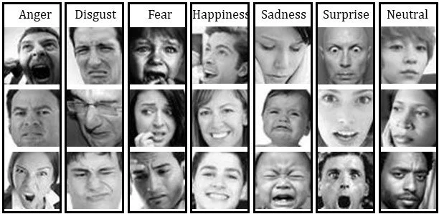
Dataset Description (FER-2013)
Emotion | Samples
Angry | 4953
Disgust | 547
Fear | 5121
Happy | 8989
Neutral | 6198
Sad | 6077
Surprise | 4002
Total Images | 35,887

Slide 11
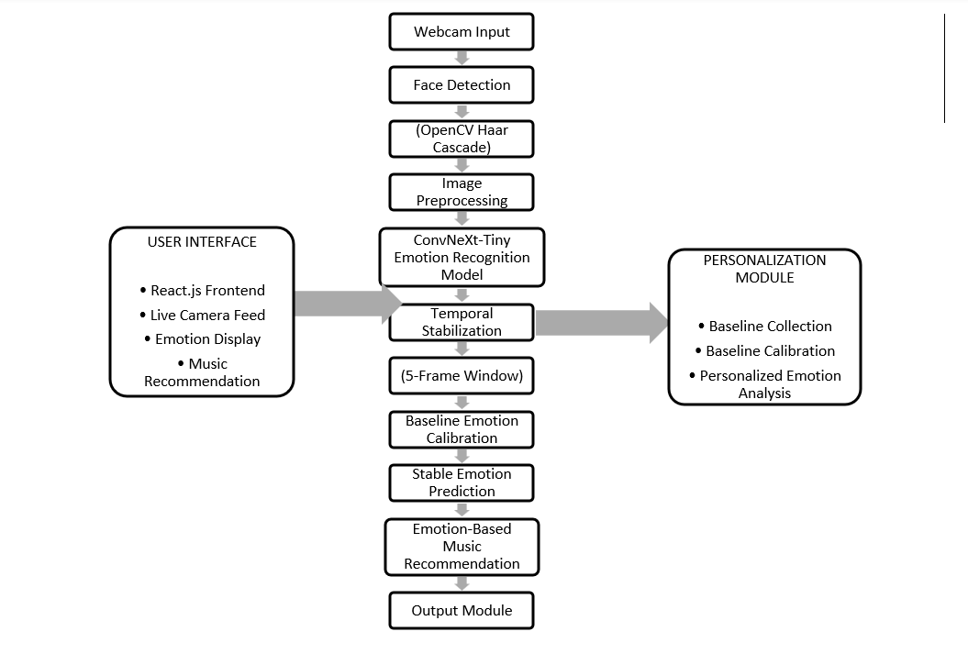
System Architecture

Slide 12
Methodology
1. Real-time video frames are captured through the webcam.
2. OpenCV Haar Cascade is used to detect and extract the facial region.
3. The detected face is preprocessed through resizing, RGB conversion, and normalization.
4. The preprocessed image is passed to the ConvNeXt-Tiny model for emotion classification.
5. Temporal probability smoothing is applied using a 5-frame rolling buffer to reduce prediction fluctuations.
6. Baseline emotion calibration personalizes emotion interpretation based on the user's neutral facial baseline.
7. The final stable emotion prediction is displayed through the web application along with music recommendations.

Slide 13
Webcam
Face Detection
Preprocessing
ConvNeXt-Tiny
Temporal Smoothing
Baseline Calibration
Emotion Prediction
Music Recommendation

Slide 14
Model Development and Experimental Comparison
• Multiple transfer learning architectures were evaluated on the FER-2013 dataset.
• Progressive improvements were achieved through fine-tuning, data augmentation, and optimization techniques.
• ConvNeXt-Tiny achieved the highest overall accuracy and demonstrated superior generalization performance.
• Therefore, ConvNeXt-Tiny was selected as the final deployment model.
Model | Test Accuracy (%)
Baseline ResNet50 | 65.03
ResNet50V2 | 67.99
Progressive Unfreezing ResNet50V2 | 69.66
EfficientNet-B0 | 71.8
ConvNeXt-Tiny | 72.97

Slide 15
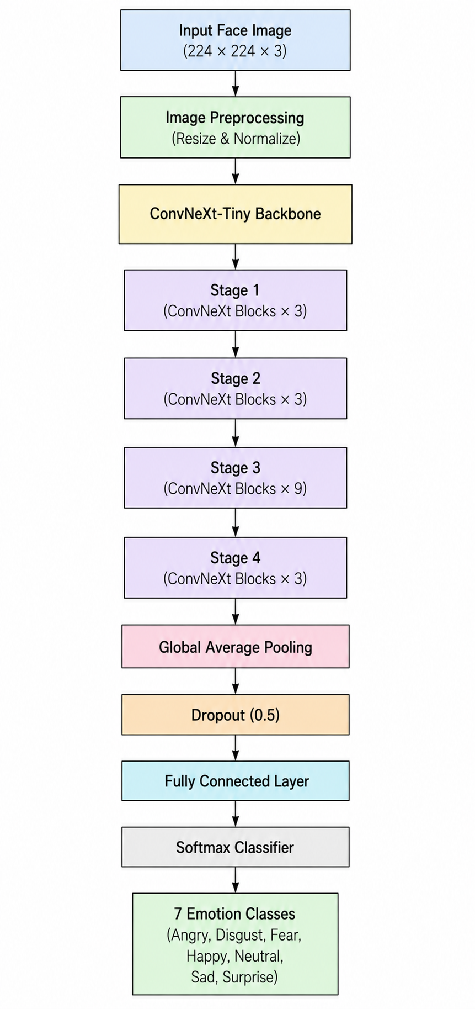
ConvNeXt-Tiny Architecture
• Pretrained on ImageNet
• Fine-tuned on FER-2013 dataset
• Uses hierarchical feature extraction
• Dropout used to reduce overfitting
• Outputs seven emotion classes
• Achieved 72.97% test accuracy
• Achieved 74.2% Validation Accuracy

Slide 16
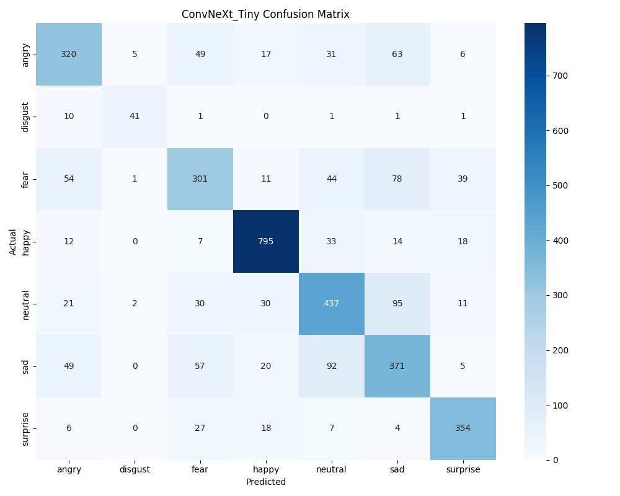
Results and Performance Evaluation
Model | Test Accuracy (%)
Baseline ResNet50 | 65.03
ResNet50V2 | 67.99
Progressive Unfreezing ResNet50V2 | 69.66
EfficientNet-B0 | 71.8
ConvNeXt-Tiny | 72.9

Slide 17
Results and Performance Evaluation
Metric | Value (%)
Accuracy | 72.97
Precision | 72.87
Recall | 72.97
F1-Score | 72.87
• ConvNeXt-Tiny achieved the highest accuracy among all evaluated models.
• Temporal probability smoothing improved prediction stability in real-time inference.
• Baseline-aware calibration enabled personalized emotion interpretation.
• The proposed system successfully performed real-time emotion recognition and recommendation.

Slide 18
Conclusion and Future Scope
Conclusion
The proposed Baseline-Aware Temporal Facial Emotion Recognition system was successfully developed using OpenCV and the ConvNeXt-Tiny deep learning architecture. The system effectively performs real-time facial emotion recognition by combining face detection, emotion classification, temporal probability smoothing, and baseline-aware calibration. The incorporation of temporal stabilization improved prediction consistency, while personalized baseline calibration enhanced emotion interpretation. Experimental evaluation on the FER-2013 dataset demonstrated strong performance, achieving an accuracy of 72.97%, thereby validating the effectiveness of the proposed approach.

Slide 19
Conclusion and Future Scope
Future Scope
Future enhancements to the proposed system may include the integration of multimodal emotion recognition by combining facial expressions with speech and physiological signals. The system can also be optimized for deployment on mobile and edge devices to support real-time applications with limited computational resources. Furthermore, advanced recommendation mechanisms and intelligent virtual assistants can be incorporated to provide more personalized user experiences. Exploring transformer-based architectures and attention mechanisms may further improve emotion recognition accuracy and robustness in real-world environments.

Slide 20
References
[1] A. Mollahosseini, D. Chan, and M. H. Mahoor, “Going deeper in facial expression recognition using deep neural networks,” IEEE Winter Conference on Applications of Computer Vision (WACV), pp. 1–10, 2019.
[2] Y. Khaireddin and Z. Chen, “Facial emotion recognition: State of the art performance on FER2013,” arXiv preprint arXiv:2105.03588, 2021.
[3] S. Minaee, M. Minaei, and A. Abdolrashidi, “Deep-emotion: Facial expression recognition using attentional convolutional network,” Sensors, vol. 21, no. 9, pp. 1–18, 2021.
[4] S. Li and W. Deng, “Deep facial expression recognition: A survey,” IEEE Transactions on Affective Computing, vol. 13, no. 3, pp. 1195–1215, 2022.
[5] F. Wang, S. Xiang, and J. Pan, “Multimodal emotion recognition using deep learning techniques,” International Journal of Computer Vision and Signal Processing, vol. 14, no. 2, pp. 45–57, 2022.
[6] J. Zeng, Y. Hu, and K. Zhao, “Transformer-based facial emotion recognition framework,” IEEE Access, vol. 11, pp. 34567–34578, 2023.

Slide 21
References
[7] Z. Fu, H. Liu, and P. Wang, “Hybrid CNN-RNN model for real-time facial emotion analysis,” Journal of Artificial Intelligence Research, vol. 18, no. 4, pp. 221–233, 2023.
[8] G. Sonkavde, R. Mahajan, and S. Patil, “Artificial intelligence techniques for human emotion and behavior analysis,” International Journal of Advanced Computer Science and Applications, vol. 14, no. 1, pp. 112–121, 2023.
[9] A. Sharma, P. Verma, and R. Gupta, “Lightweight CNN model for real-time emotion recognition,” Procedia Computer Science, vol. 225, pp. 105–114, 2024.
[10] H. Kim and S. Lee, “Graph neural networks for facial emotion recognition,” IEEE Access, vol. 12, pp. 55210–55222, 2024.
[11] R. Ahmed, T. Khan, and S. Ali, “Personalized baseline calibration for adaptive emotion recognition,” Journal of Machine Learning Applications, vol. 9, no. 2, pp. 88–97, 2025.
[12] X. Chen, L. Zhang, and Y. Zhou, “Multimodal affective computing framework for intelligent human interaction,” IEEE Transactions on Multimedia, vol. 27, pp. 145–158, 2025.

Slide 22
THANK YOU

